Slide 1
Unit 2 - Lecture 15
A* algorithm

Slide 2
A* algorithm
The algorithm At first described by Hart, Nilsson and Raphael combines the best features of B&B. Dijkstra's algorithm and Best First Search.
Both B&B and Dijkstra's algorithm extend the least cost partial solution.
While the later is designed to solve a general problem, the former uses a similar blind approach, even though it has a specific goal to achieve.
B&B generates a search tree that may have duplicate copies of the same nodes with different costs; while Dijkstra's algorithm searches over a given graph, keeping exactly one copy of each node and back pointers for the best routes.
Neither has a sense of direction.

Slide 3
Best First Search does have a sense of direction.
It uses a heuristic function to decide which of the candidate nodes is likely to be closest to the goal, and expands that.
However, it does not keep track of the cost incurred to reach that node, as illustrated in next figure.
Best First Search only looks ahead from the node n, seeking a quick path to the goal, while B&B only looks behind, keeping track of the best paths found so far.
Algorithm A* does both.
A* uses an evaluation function f(node) to order its search.
f(n) = Estimated cost of a path from Start to Goal via node n.
Let f*(n) be the (actual but unknown) cost of an optimal path S -> n -> G as described above, of which f(n) is an estimate.

Slide 5
The evaluation function has two components as shown in next figure.
One, backward looking, g(n), inherited from B&B, the known cost of the path found from S to n.
The other, forward looking and goal seeking, h(n), inherited from Best First Search, is the estimated cost from n to G.
f*(n) = g*(n) + h*(n)
f(n) = g(n) + h(n)
where g*(n) is the optimal cost from S to n, and h*(n) is the optimal cost from n to G.
Note that g*(n) and h*(n) may not be known.
What are known are g(n) which can be thought of as an estimate of g*(n) that the algorithm maintains, and h(n) the heuristic function that is an estimate of h*(n).

Slide 6
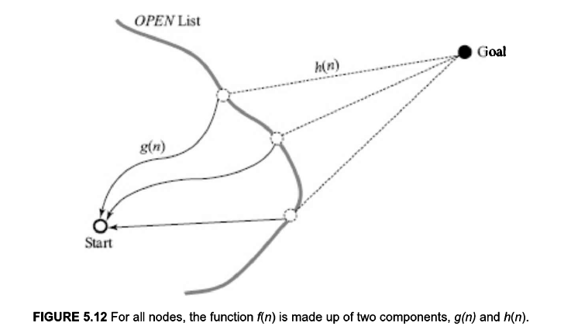

Slide 7
In general, g*(n) will be a lower than g(n), because the algorithm may not have found the optimal path to n yet.
g(n) >= g*(n)
The heuristic value h(n) is an estimate of the distance to the goal.
In order for the algorithm to guarantee an optimal solution, it is necessary that the heuristic function underestimate the distance to the goal.
h(n) <= h*(n)
We also say that h(n) is a lower bound on h*(n).
If the above condition is true then A* is said to be admissible; that is, it is guaranteed to find the optimal path.
we illustrate with an example the intuition behind the condition that the heuristic function should underestimate the actual cost.

Slide 8
Let an instance of A* have two nodes, P and Q on the OPEN list, such that both are one move away from the goal.
Let the cost of reaching both P and Q be the same, say 100.
Let the actual cost of the move from P to G be 30, and let the cost of the move from Q to G be 40, as shown in next figure.
Let there be two versions of A*, named A₁* and A₂*, employing two heuristic functions, h1(n) and h2(n).
Let us assume that both have found the paths up to P and Q with cost 100.
Let both heuristic functions erroneously evaluate Q to be nearer to the goal G than P is. But let A₁* overestimate the distance to G; thus, in fact becoming inadmissible, while A₂* underestimates the distance, as illustrated next:

Slide 9
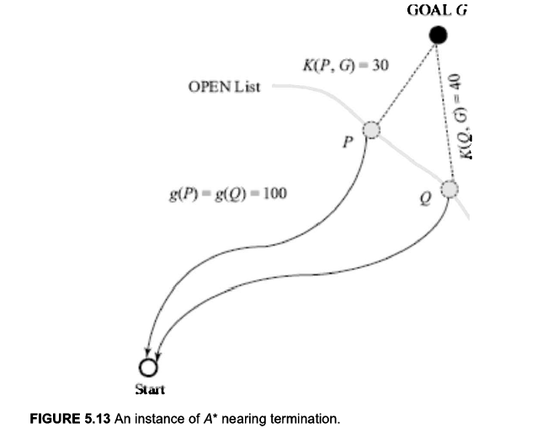

Slide 10
h1 (P)= 50 h1(Q) = 45
and
h2(P) = 20 h2(Q) = 15
Let us trace the progress of A₁* first.
Assuming that only P and 0 are in the OPEN list, the f values are
f1(P)= g1(P)+ h1(P)= 100 + 50 = 150
f1(Q) = g1(Q) + h1(Q) = 100 + 45 = 145
Since it has the smaller f-value, A₁* picks Q and expands it generating the node G with g1(G) = 100 + 40 = 140.
It now has two nodes on OPEN, P and G with the values,
f1(P)= g1(P)+ h1(P)= 100 + 50 = 150
f1(G)=g1(G)+h1(G)=140+0=140

Slide 11
It now picks the goal G and terminates, finding the longer path with cost 140.
A₂* too starts off by picking the node Q in the following position.
f2(P)= g2(P)+ h2(P)= 100 + 20 = 120
f2(Q) = g2(Q) + h2(Q) = 100 + 15 = 115
It also finds a path to G with a cost of 140.
For the next move, however, it picks P instead of G in the following position,
f2(P) = g2(P) + h2(P) = 100 + 20 = 120
f2(G) = 92(G) h2(G)= 140 + 0 = 140
Thus, A₂* picks P instead of G and finds the shorter path to G.
This happened because it underestimated the cost of reaching the goal through P.

Slide 12
The algorithm A* is described in next slide.
Like the Dijkstra's Algorithm, it uses a graph structure but one which it generates on a need basis during search.
It is also called a graph search algorithm.
It keeps track of the best route it has found so far to every node on the OPEN and CLOSED, via the parent link.
Since it may find cheaper routes to nodes it has already expanded, a provision to pass on any improvements in cost to successors of nodes generated earlier, has to be made.

Slide 15
The representation used here is different from the nodePair representation
Instead, an explicit parent pointer is maintained.
This has been done because we want to keep only one copy of each node, and reassign parents when the need arises.
Consequently, the definition of the ReconstructPath function will change.
The revised definition is left as an exercise for the user.
In the following example, the node labeled N is about to be expanded.
The values shown in the nodes are the g values.
The double lined boxes are in the set CLOSED and the single lined ones in OPEN.

Slide 16
Each node, except the start node, has a parent pointer.
The dotted arcs emanating from N show the successors of N, including a new node whose g value is yet to be computed.

Slide 17
Figure in next slide shows the changes that are made after the node N is expanded.
Cheaper paths were found for some of the nodes on OPEN.
Likewise, for some nodes on CLOSED too, and in their case the improved g-values had to be passed on to their descendents as well.

Slide 19
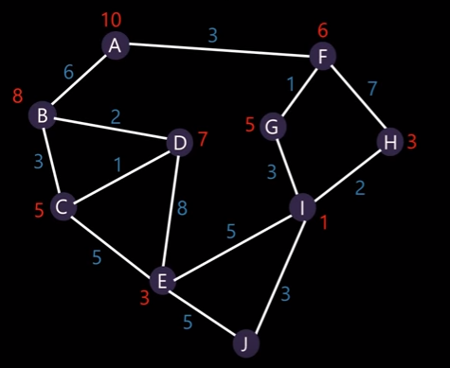
Calculate shortest path for this example

